Slide 1
CS118 – Programming Fundamentals
Lecture # 15
Monday, October 14, 2019
FALL 2019
FAST – NUCES, Faisalabad Campus
Course Instructor:
Ebad Majeed
Slides Credit:
Rizwan Ul Haq

Slide 2
Nested Control Structures (Nested Loops)
A nested loop is a loop inside the body of another loop
Example:
for (row = 1; row <= 3; row++)
{
for (col = 1; col <= 3; col++)
{
cout << row * col << endl;
}
}
outer loop
inner loop

Slide 3
Nested Control Structures
To create the following pattern:
*
**
***
****
*****
We can use the following code:
for (int i = 1; i <= 5 ; ++i)
{
for (int j = 1; j <= i; ++j)
cout << "*";
cout << endl;
}

Slide 4
Nested Control Structures (cont'd.)
What is the result if we replace the first for statement with the following?
for (int i = 5; i >= 1 ; i--)
Answer:
*****
****
***
**
*

Slide 5
Example
for ( int i = 1; i <= 5; i++)
{
for( int j = 1; j <= 10; j++)
cout << setw(3) << i * j ;
cout << endl ;
}

Slide 6
Notes on Nested Loops
Inner loop goes through all its repetitions for each repetition of outer loop
Inner loop repetitions complete sooner than outer loop
Total number of repetitions for inner loop is product of number of repetitions of the two loops

Slide 7
Output = ?
for (int y = 1; y <= 3; ++y) {
for (int x = 1; x <= 3; ++x) {
cout << x * y << " ";
}
cout << "\n";
}

Slide 8
loop Structures
Problem statement
A college has a list of test results (1 = pass, 2 = fail) for 10 students. Write a program that analyzes the results. If more than 8 students pass, print “Raise Tuition”.
Notice that
Program processes 10 results
Fixed number, use counter-controlled loop
Two counters can be used
One counts number that passed
Another counts number that fail
Each test result is 1 or 2
If not 1, assume 2

Slide 9
loop Structures
Top level outline
Analyze exam results and decide if tuition should be raised
First refinement
Initialize variables
Input the ten quiz grades and count passes and failures
Print a summary of the exam results and decide if tuition should be raised
Refine
Initialize variables
to
Initialize passes to zero
Initialize failures to zero
Initialize student counter to one

Slide 10
loop Structures
Refine
Input the ten quiz grades and count passes and failures
to
While student counter is less than or equal to ten
Input the next exam results
If the student passed
Add one to passes
Else
Add one to failures
Add one to student counter

Slide 11
loop Structures
Refine
Print a summary of the exam results and decide if tuition should be raised
to
Print the number of passes
Print the number of failures
If more than eight students passed
Print “Raise tuition”

Slide 12
#include<iostream>
using namespace std;
int main()
{
int passes = 0; //number of passes
int failures = 0; //number of failures
int stdCounter = 1; //student counter
int result ; //one exam result
//process 10 users using counter-controlled loop
while(stdCounter <= 10)
{
//prompt user for input and obtain value from user
cout << "Exam Result ( 1 = pass , 2 = fail): ";
cin >> result;
//if 1 increment passes
if(result == 1) //if-else nested in while loop
++passes;
else //if result not one increment failures
++failures;
//increment student counter so that loop can terminate
++stdCounter;
}//end while

Slide 13
//termination phase
cout << "Passes = " << passes <<endl;
cout << "Failures = " << failures << endl;
// if more than 8 students passed then raise tution
if(passes > 8)
cout << "Raise Tution" << endl;
return(0);
}

Slide 14
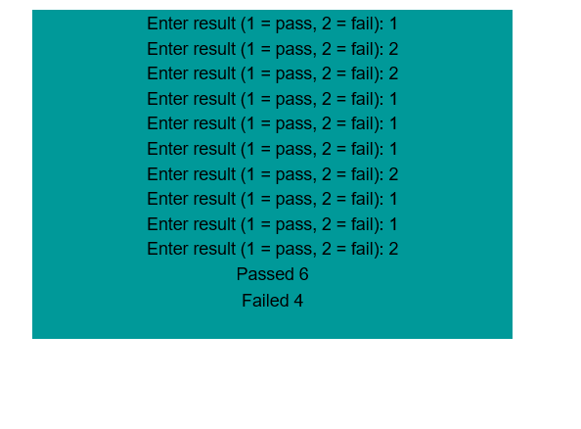

Slide 15
Quiz: 01
Write a program to take 10 integers from user, print the sum of all integers at the end, if user enters a negative number; simply ignore that input by displaying an error message.

Slide 16
Quiz: 02
What is the difference b/w break and continue in a loop?
What will be the output of this program:
Int main()
{
For(int i = 0; i < 25; i/2)
For(int j=0; j<=i; j++)
{
Cout<<i<<“ ”;
}
Return 0;
}

Slide 17
Avoiding Bugs by Avoiding Patches
Software patch
Piece of code written on top of an existing piece of code
Intended to fix a bug in the original code
Some programmers address the symptom of the problem by adding a software patch
Should instead resolve underlying issue

Slide 18
Debugging Loops
Loops are harder to debug than sequence and selection structures
Use loop invariant
Set of statements that remains true each time the loop body is executed
Most common error associated with loops is off-by-one

Slide 19
Examples

Slide 20
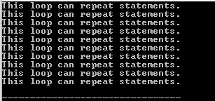



Example program
What is the out put of following code segment?
int count = 0;
while (count++ < 5)
cout << "This loop repeats statements." <<endl;
What is the out put of following code segment?
int count = 5;
while(--count > 0)
cout << count << " " ;
cout << endl ;
What is the out put of following code segment?
int count = 5 ;
while (count-- > 0)
cout << count << " " ;
cout << endl;
What is the out put of following code segment?
int count = 1 ;
while (count++ <= 5)
cout << count * (count - 2) << " " ;
cout << endl;

Slide 21
Infinite loop
Infinite loop

Slide 22


Slide 23

Suppose that the input is 38 35 75 44 -1. What is the output of the following code? Assume all variables are properly declared.
sum = 0;
cin >> num;
for (j = 0; j <= 3; j++)
{
cin >> num;
sum = sum + num;
}
cout << "Sum = " << sum << endl;

Slide 24


Slide 25
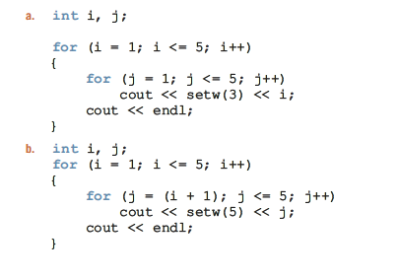



Slide 26
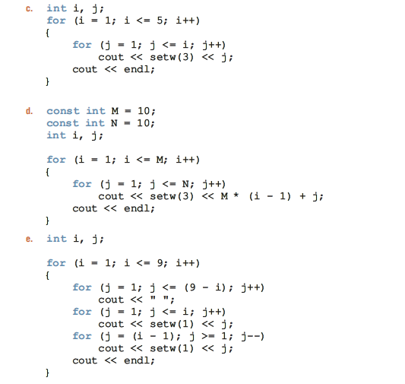

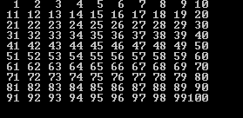


Slide 27
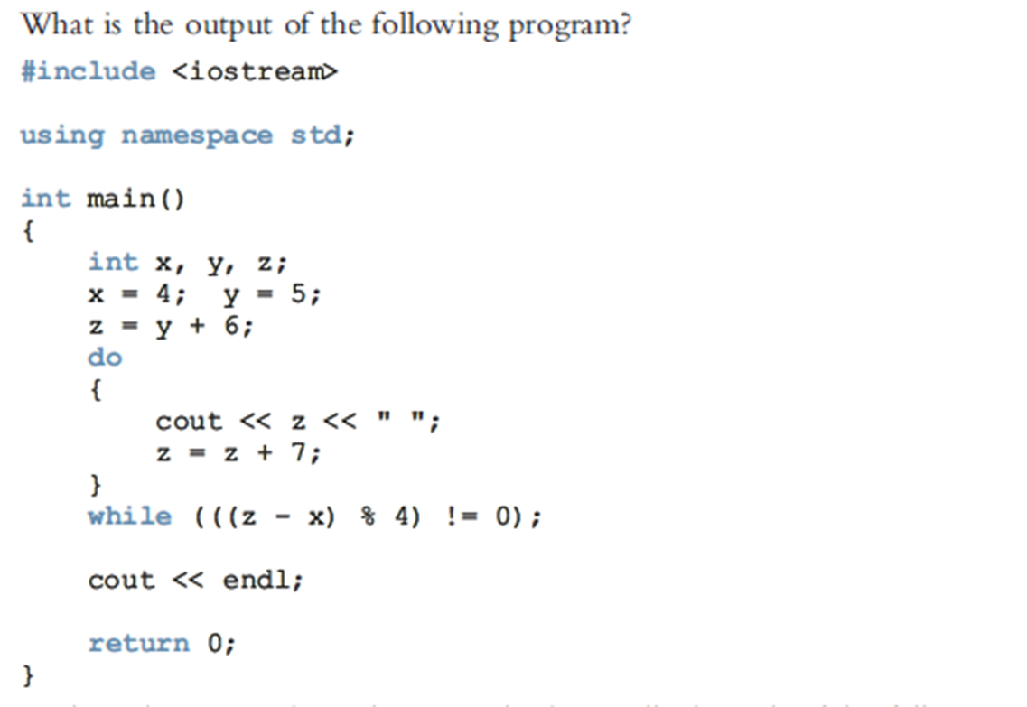


Slide 28
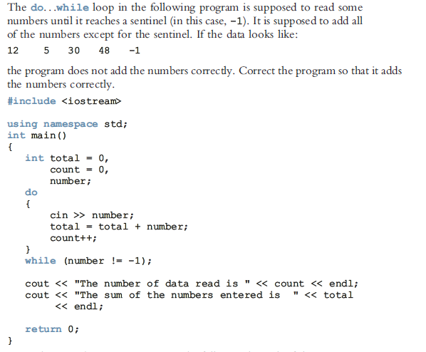


Slide 29
Summary
C++ has three looping (repetition) structures:
while, for, and do…while
while, for, and do are reserved words
while and for loops are called pretest loops
do...while loop is called a posttest loop
while and for may not execute at all, but do...while always executes at least once

Slide 30
Summary (cont'd.)
while: expression is the decision maker, and the statement is the body of the loop
A while loop can be:
Counter-controlled
Sentinel-controlled
Flag-controlled
EOF-controlled
In the Windows console environment, the end-of-file marker is entered using Ctrl+z

Slide 31
Summary (cont'd.)
for loop: simplifies the writing of a counter-controlled while loop
Putting a semicolon at the end of the for loop is a semantic error
Executing a break statement in the body of a loop immediately terminates the loop
Executing a continue statement in the body of a loop skips to the next iteration

Slide 32
Questions

